Slide 1
Epistle IV: To Richard Boyle, Earl of Burlington
By Alexander Pope

Slide 2
Quick Facts
Born on May 21st, 1688
Died on May 30th, 1744
Devout Roman Catholic
Plagued by tuberculosis
Only 4’6” tall
Never married

Slide 3
Style
Pope was a classicist
Focused on the value of ancient artistic styles
Often emulates Homer, Virgil, etc.
Wrote in heroic couplets
Rhyming iambic pentameter couplets

Slide 4
The Rape of the Lock
Published in 1712, again in 1714
A “heroi-comical” or “tragi-comic” poem
A style of poetry parodying epic poetry
The Rape of the Lock is divided into 5 cantos
The story of a stolen lock of hair

Slide 5
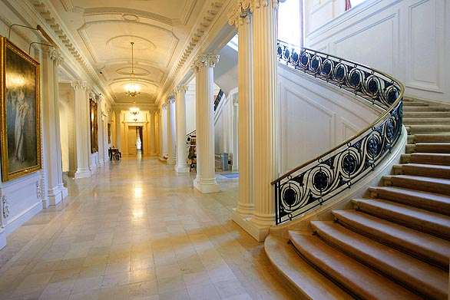
Aesthetics: Good “Neo-Classical” Taste
“Glorious” (23) buildings “of use” (24)

Slide 6
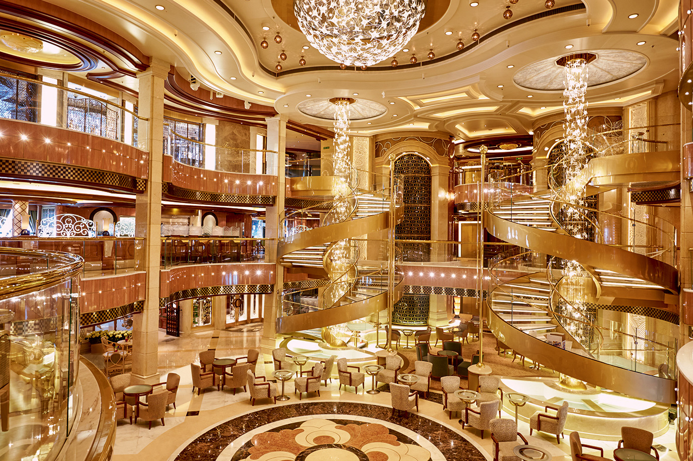
Bad “Neo-Classical” Taste
plans of “imitating fools” (26)

Slide 7
Three Sections of the Poem
Scholar I. R. F. Gordon divides Alexander Pope’s “Epistle to Burlington” into three parts.
I. Lines 1-98 = an aesthetic discussion of good and bad taste in landscape and architecture
II. Lines 99-176 = Timon’s Villa as exemplar of bad taste.
III. Lines 177 to the end = envisioning of a future when rulers and aristocracy will steward wealth in ways that bring peace to Britain and help people flourish.

Slide 8
Common Sense & Nature
Pope argues that good sense is “the gift of Heav’n” (43), which we ignore to our detriment, “a light, which in yourself you must perceive” (45) and which cannot be gained through reading books.
Above all, he believes that landscape and architectural design need guidance by sense and by nature in order to succeed, adding “let Nature never be forgot” (50).
Let not each beauty ev’rywhere be spied, Where half the skill is decently to hide. He gains all points who decently confounds, Surprises, varies, and conceals the bounds. (53-56)

Slide 9
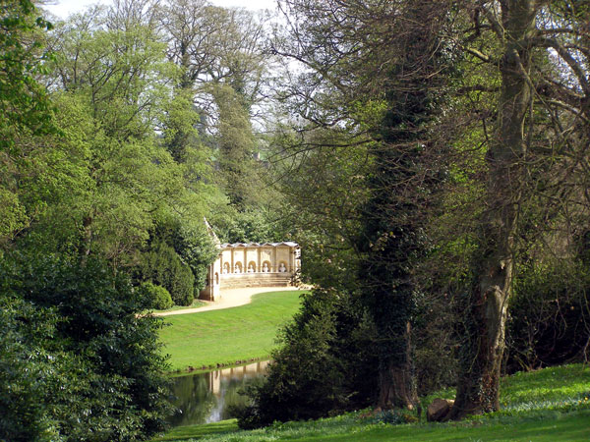
“Genius of the Place” (57)
Nature shall join you, time shall make it grow A work to wonder at—perhaps a Stowe. (69-70)

Slide 10
Versailles = Proud, Unnatural and Lacking Sense (71)

Slide 11
Pope Preferred Treed Landscapes with Modest Architecture Nestled in Woods
Through his young woods how pleas’d Sabinus stray’d, Or sat delighted in the thick’ning shade, With annual joy the redd’ning shoots to greet, Or see the stretching branches long to meet! His son’s fine taste an op’ner vista loves, Foe to the dyads of his father’s groves; One boundless green, or flourish’d carpet views, With all the mournful family of yews; The thriving plants ignoble broomsticks made, Now sweep those alleys they were born to shade. (89-98)

Slide 12
Questions for Timon’s Villa (Group Work)
What is wrong with Timon’s Landscape gardening? (lines 99-132)
What is wrong with with Timon’s study & chapel? (133-50)
What is wrong with Timon’s hospitality? (151-68)
Question for entire class: What benefit does this “vain” effort bring? (169-72)

Slide 13
A Modern “French Chateau”: Private Folly?

Slide 14
A Vision of “Another Age”
Pope’s vision of a future age not guided by vanity:
Land used for agriculture (175-76)
Aesthetics subordinated to pragmatism (179-180)
Tenants well cared for by their Lord (183-84)
“Ample lawns” (185) for grazing cattle, not for display.
Forests not “for pride or show” (187) but for timber.
Concludes by addressing reader: “You too proceed . . .” (191)

Slide 15
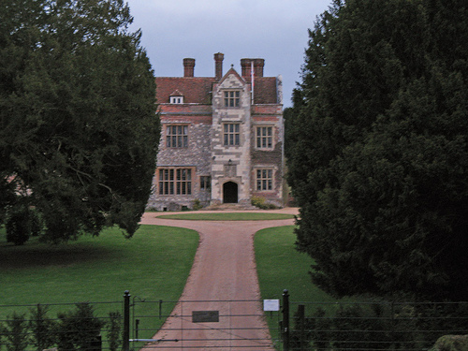
Chawton House Library: Stewardship for Public Benefit
Ends with suggestions: “the old repair” (192); “public ways extend, / Bid temples, worthier of God, ascend” (197). “These honours, peace to happy Britain brings” (203).

Slide 16
Tyndale University College: “The old repair” (192) … “These honours, peace to happy [Canada] brings” (203).

